Slide 1
INFRASTRUCTURE LITERACY
AARNet Partnerships in support of eResearch
ALIA Universities & Research Libraries - 14 September 2017
Notes:
Here to talk about AARNet’s Partnerships in support of eResearch. Bring a focus to that discussion around this topic: infrastructure literacy. There is a gap in eResearch in knowledge of research infrastructure and the capacity to use it. We are using this term: infrastructure literacy, to capture this idea and we reflect upon the role that library and information professionals working in research and education play, in building digital capability, as our partners.

Slide 2
AARNet partnerships in support of eResearch
AARNet
Advanced Research Network
Digital Disruption
Partnerships in eResearch
Pathways
Humanities research
Citizen science
Infrastructure Literacy
Digital Capabilities
Data Handling
Network Know-How
Challenges (in Repositioning)
AARNet as a LIS Sector Partner

Slide 3
OUR STRATEGIC FOCUS
Delivering Australia’s R&E network
1
Growing the R&E community
2
Building Services capability
3
Ensuring financial sustainability
4

Slide 4
ADVANCED RESEARCH NETWORK

Slide 5
AARNet connects Australia to the global research and education community, the public internet, and resources such as scientific instruments, data storage, computational facilities, content and service providers, across multiple 10, 40 and 100 Gigabit per second links.
Australia’s Academic and Research Network (AARNet) is a national resource - a National Research and Education Network.

Slide 6
Australia’s National Broadband Network
Download (Mbps) | Upload (Mbps)
12 | 1
25 | 5
25 | 10
50 | 20
100 | 40
Notes:
Link accessed 26/9/2016
http://www.nbnco.com.au/sell-nbn-services/products-services-pricing/Product-identifier/wholesale-speeds.html
http://www.news.com.au/technology/online/nbn/new-zealands-internet-is-about-to-leave-us-in-the-dust/news-story/075ef0b1c18d69c9b319fdd6feb8995b

Slide 7
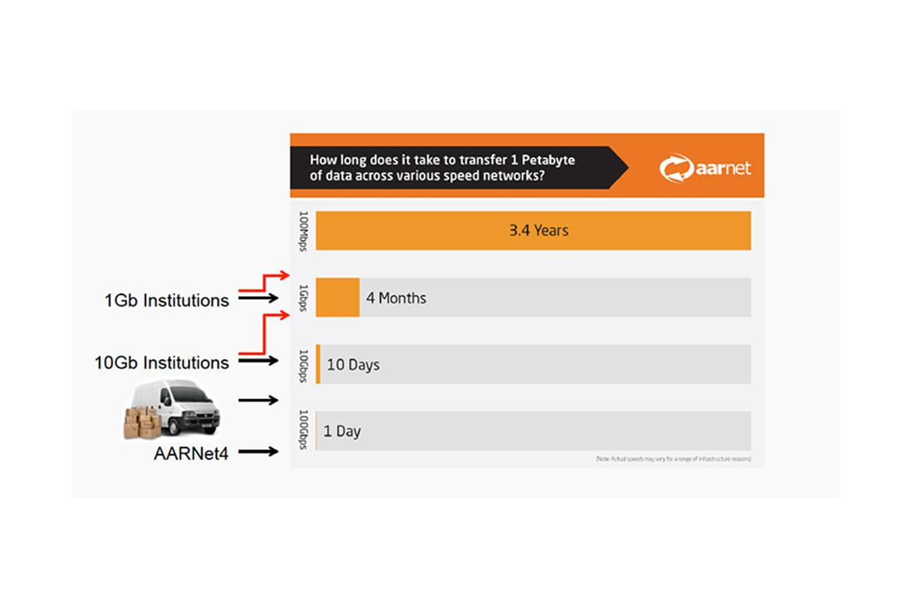

Slide 8
Latency
Low latency/high bandwidth
Low latency/low bandwidth
Notes:
http://www.plugthingsin.com/internet/speed/latency/
“For example, if you have a real low latency, but you have a small bandwidth, it’ll take longer for information to travel from point A to point B compared to a connection that has a low latency and high bandwidth. To put this into perspective, 5 Nascar race cars will get from point A to point B faster if they’re on a 5 lane freeway (low latency, high bandwidth) compared to the same number of cars making the same trip down a 1 lane freeway (low latency, small bandwidth).”

Slide 9
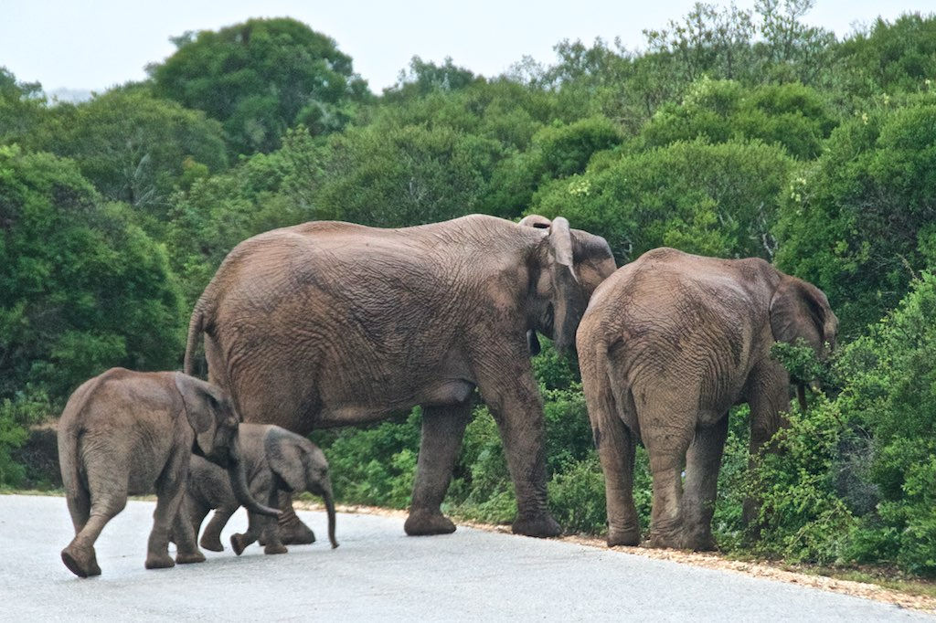
Notes:
https://www.flickr.com/photos/birdbrian/33907040906/
https://creativecommons.org/licenses/by/2.0/

Slide 10
The national research and education network (NREN) has been purpose built.
“Elephant” Flows

Slide 11
Strong partnerships
Service orientation
Build & maximize networks
Research infrastructure

Slide 12
DIGITAL DISRUPTION
Notes:
https://www.flickr.com/photos/quinet/11960457934/
https://creativecommons.org/licenses/by/2.0/

Slide 13
DIGITAL DISRUPTION
REFOCUSING
REPOSITIONING

Slide 14
Notes:
https://www.flickr.com/photos/quinet/11960457934/
https://creativecommons.org/licenses/by/2.0/

Slide 15
Notes:
https://www.flickr.com/photos/quinet/11960457934/
https://creativecommons.org/licenses/by/2.0/

Slide 16
Notes:
https://www.flickr.com/photos/quinet/11960457934/
https://creativecommons.org/licenses/by/2.0/

Slide 17
Notes:
https://www.flickr.com/photos/quinet/11960457934/
https://creativecommons.org/licenses/by/2.0/

Slide 18
Notes:
https://www.flickr.com/photos/quinet/11960457934/
https://creativecommons.org/licenses/by/2.0/

Slide 19
Notes:
https://www.flickr.com/photos/quinet/11960457934/
https://creativecommons.org/licenses/by/2.0/

Slide 20
Notes:
https://www.flickr.com/photos/quinet/11960457934/
https://creativecommons.org/licenses/by/2.0/

Slide 21
Notes:
https://www.flickr.com/photos/quinet/11960457934/
https://creativecommons.org/licenses/by/2.0/

Slide 22
REFOCUSING & REPOSITIONING
Notes:
https://www.flickr.com/photos/quinet/11960457934/
https://creativecommons.org/licenses/by/2.0/

Slide 23
PARTNERSHIPS
Notes:
https://www.flickr.com/photos/quinet/11960457934/
https://creativecommons.org/licenses/by/2.0/

Slide 24
Universities
Government
Industry
AARNet shareholders, customers, and partners

Slide 25
Information Technology
Library
Research
Senior Management
Organisational touch points the AARNet team liaise with on delivery and transformation of network and services

Slide 26
Science
Cultural Heritage
Health
K-12 Schools
AARNet provides network and services to different sectors of the Australian research and education landscape

Slide 27
Digital Humanities
eResearch
NRENs
Sample of national and international communities of practice the AARNet team is linked into

Slide 28
Universities
Government
Industry
Information Technology
Library
Research
Senior Management
Science
Cultural Heritage
Health
K-12 Schools
Digital Humanities
eResearch
NRENs

Slide 29
ERESEARCH
Notes:
https://www.flickr.com/photos/quinet/11960457934/
https://creativecommons.org/licenses/by/2.0/

Slide 30
Paths
Humanities research
Citizen science
Infrastructure literacy
AARNet partnerships that support eResearch are complex and evolving, and vital to our role in enabling knowledge creation and innovation.
Notes:
https://www.aarnet.edu.au/images/uploads/resources/About_AARNet-web-FINAL.pdf

Slide 31
Digital capabilities
Data handling
Network know-how
AARNet removes geographical, technical and commercial barriers to the creation of new educational experiences and research-led innovation.
Notes:
https://www.aarnet.edu.au/images/uploads/resources/About_AARNet-web-FINAL.pdf

Slide 32
Universities
Government
Industry
Information Technology
Library
Research
Senior Management
Science
Cultural Heritage
Health
K-12 Schools
Digital Humanities
eResearch
NRENs

Slide 33
Universities
Government
Industry
Information Technology
Library
Research
Senior Management
Science
Cultural Heritage
Health
K-12 Schools
Digital Humanities
eResearch
NRENs

Slide 34
Universities
Government
Industry
Information Technology
Library
Research
Senior Management
Science
Cultural Heritage
Health
K-12 Schools
Digital Humanities
eResearch
NRENs

Slide 35
Universities
Government
Industry
Information Technology
Library
Research
Senior Management
Science
Cultural Heritage
Health
K-12 Schools
Digital Humanities
eResearch
NRENs

Slide 36
DESIRE PATH

Slide 37
Desire paths emerge as shortcuts where constructed ways take a circuitous route, have gaps, or are non-existent.
Wikipedia
The path usually represents the shortest or most easily navigated route between an origin and destination.
Wikipedia
Notes:
https://en.wikipedia.org/wiki/Desire_path

Slide 38
Universities
Government
Industry
Information Technology
Library
Research
Senior Management
Science
Cultural Heritage
Health
K-12 Schools
Digital Humanities
eResearch
NRENs
Focus on key stakeholders and opportunities for collaboration

Slide 39
Partnerships in eResearch
Access to digital collections (cultural heritage) for research

Slide 40
Universities
Government
Industry
Information Technology
Library
Research
Senior Management
Science
Cultural Heritage
Health
K-12 Schools
Digital Humanities
eResearch
NRENs
Access to digital collections (cultural heritage) for research

Slide 41
Universities
Government
Industry
Information Technology
Library
Research
Senior Management
Science
Cultural Heritage
Health
K-12 Schools
Digital Humanities
eResearch
NRENs
Access to digital collections (cultural heritage) for research

Slide 42
Universities
Government
Industry
Information Technology
Library
Research
Senior Management
Science
Cultural Heritage
Health
K-12 Schools
Digital Humanities
eResearch
NRENs
Access to digital collections (cultural heritage) for research

Slide 43
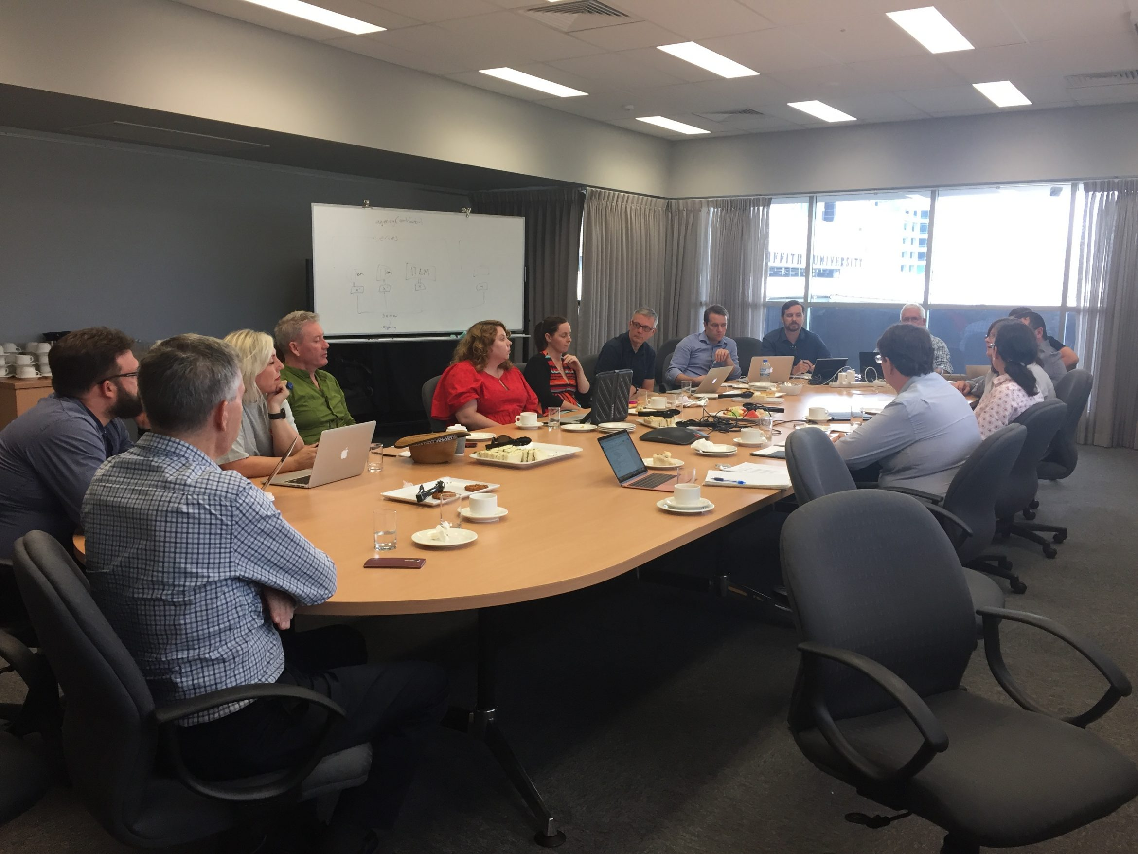
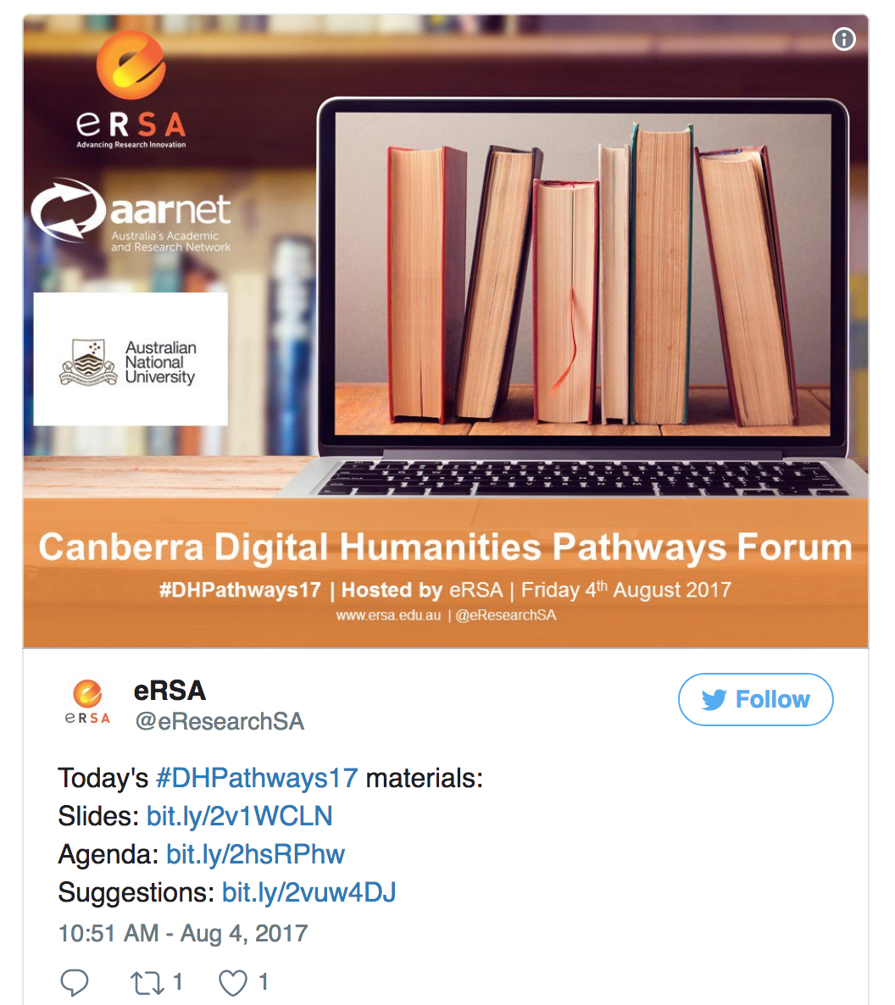
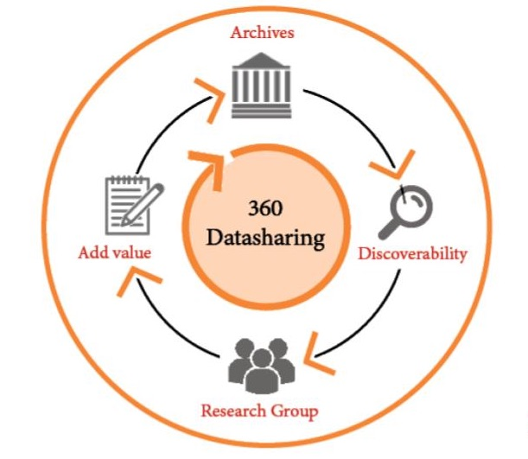
Research Data Services - Research Community Projects - Cultures and Communities
Notes:
https://storify.com/eResearchSA/digital-humanities-pathways-forum-canberra
https://www.rds.edu.au/research-communities
https://www.rds.edu.au/cultures-and-communities
https://www.ersa.edu.au/cultures-community-workshop-archive-library-research-sectors/

Slide 44
Notes:
White arrows - library expertise
Yellow arrows - archival expertise
Blue arrows - technology expertise
Green arrows - scholarly expertise

Slide 45
Partnerships in eResearch
Citizen science and engagement with cultural heritage and scholarly knowledge

Slide 46
Universities
Government
Industry
Information Technology
Library
Research
Senior Management
Science
Cultural Heritage
Health
K-12 Schools
Digital Humanities
eResearch
NRENs
Citizen science and engagement with cultural heritage and scholarly knowledge

Slide 47
Universities
Government
Industry
Information Technology
Library
Research
Senior Management
Science
Cultural Heritage
Health
K-12 Schools
Digital Humanities
eResearch
NRENs
Citizen science and engagement with cultural heritage and scholarly knowledge

Slide 48
Universities
Government
Industry
Information Technology
Library
Research
Senior Management
Science
Cultural Heritage
Health
K-12 Schools
Digital Humanities
eResearch
NRENs
Citizen science and engagement with cultural heritage and scholarly knowledge

Slide 49
Notes:
https://www.ala.org.au/who-we-are/atlas-background/atlas-partners/
https://www.ala.org.au/
Jane Black, Information Services Librarian, Geoscience Australia
https://volunteer.ala.org.au/

Slide 50
Partnerships in eResearch
Infrastructure literacy as a component of digital capability

Slide 51
Literacy
Knowledge of: ABC 123
Capacity to use: ABC 123
Enabling: People
Innovation (new ideas, attitudes, products, ways of living)
Literacy is a facet of Capability

Slide 52
Digital Literacy
Knowledge of: Computers and information resources and services
Capacity to use: Computers and information resources and services
Enabling: Research (people and ideas or questions)
Innovation (new ideas, attitudes, products, ways of living)
Digital Literacy is a facet of Digital Capability
Notes:
“Digital literacy looks beyond functional IT skills to describe a richer set of digital behaviours, practices and identities. What it means to be digitally literate changes over time and across contexts, so digital literacies are essentially a set of academic and professional situated practices supported by diverse and changing technologies. This definition quoted above can be used as a starting point to explore what key digital literacies are in a particular context eg university, college, service, department, subject area or professional environment.”
https://www.jisc.ac.uk/guides/developing-digital-literacies

Slide 53
Infrastructure Literacy
Knowledge of: Data and technological infrastructures
Capacity to use: Data and technological infrastructures
Enabling: Research (people and ideas or questions)
Innovation (new ideas, attitudes, products, ways of living)
Infrastructure Literacy is a facet of Digital Capability
Notes:
http://repository.jisc.ac.uk/6259/1/Deepening_Digital_Knowledge.pdf

Slide 54
DIGITAL CAPABILITY
JISC Framework

Slide 55
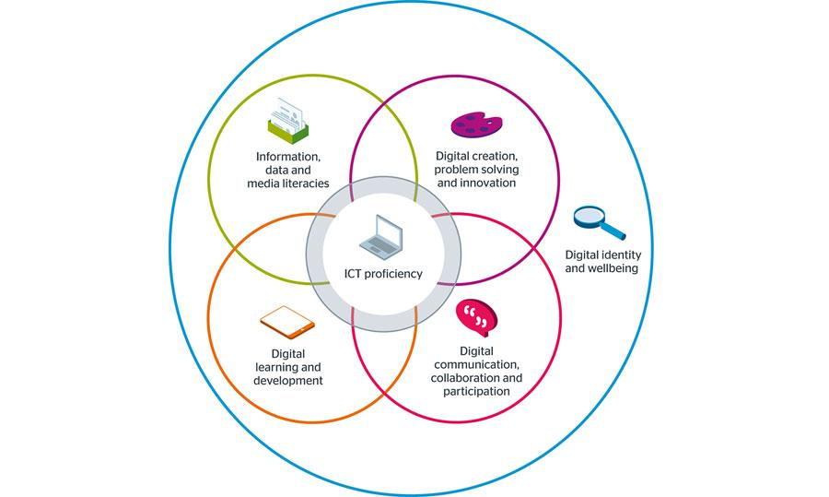
Digital Capability (JISC)
Notes:
https://www.jisc.ac.uk/rd/projects/building-digital-capability
https://www.jisc.ac.uk/guides/developing-digital-literacies

Slide 56
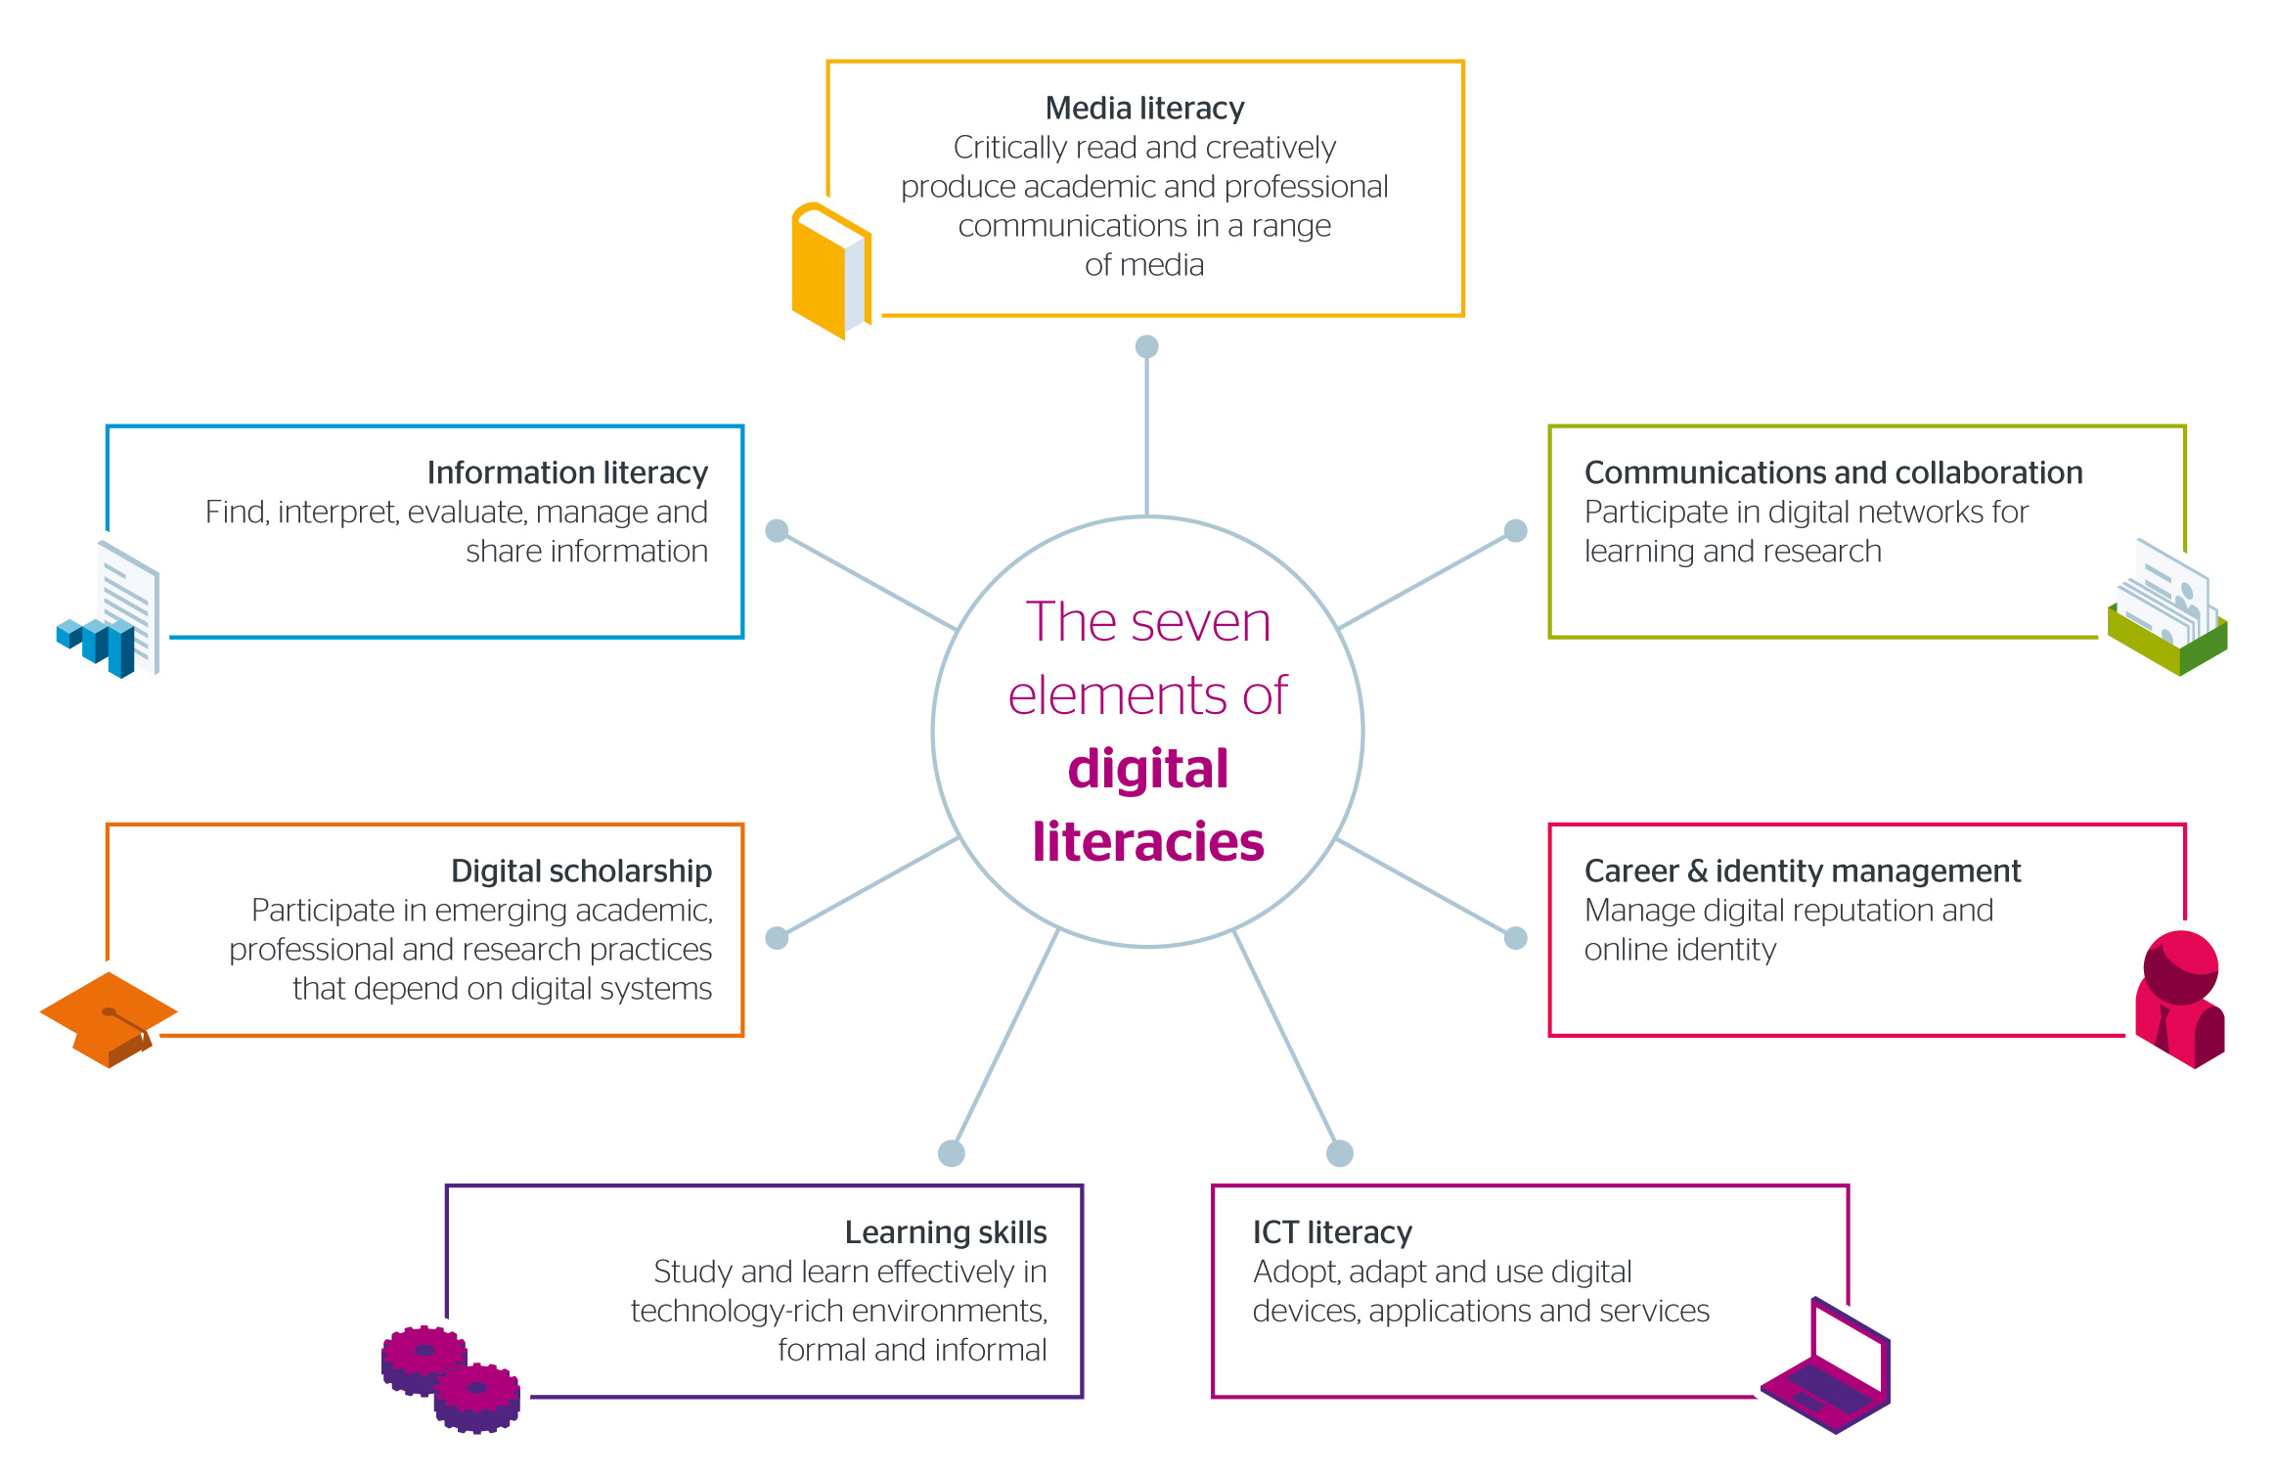
Digital Capability (JISC)
Notes:
https://www.jisc.ac.uk/rd/projects/building-digital-capability
https://www.jisc.ac.uk/guides/developing-digital-literacies

Slide 57
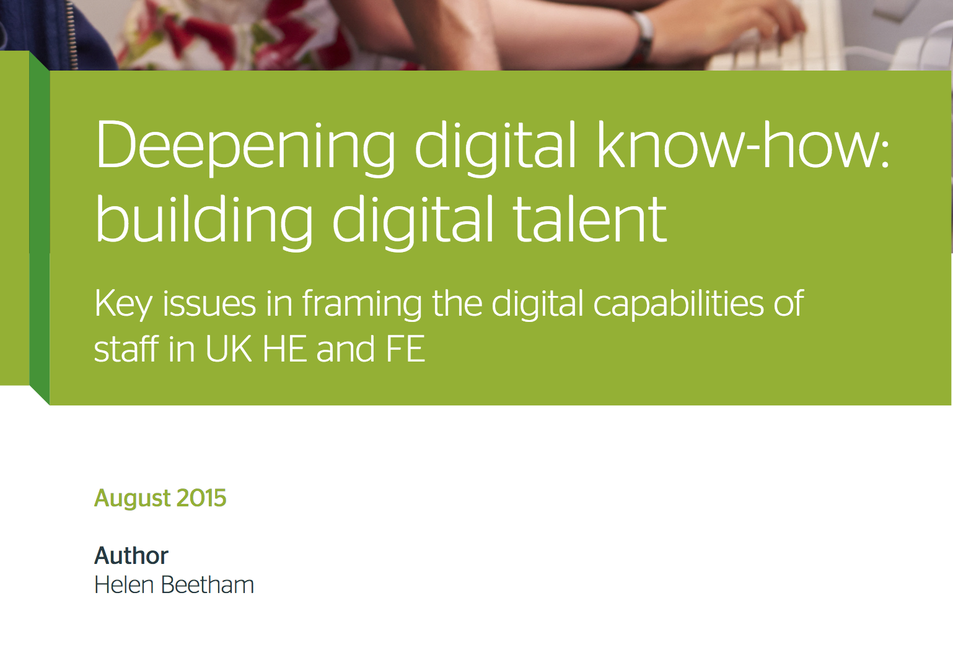
Digital Capability
“Digital Capability is intrinsic to professional practice, identity and learning.” (p14)

Slide 58
General digital capability vs Digital specialism
Notes:
“General digital capability or facility (ease with familiar devices, services and applications): is commonplace, is usually acquired informally, and can be transferred between professional and personal/social contexts of use encompasses a range of basic operations e.g. navigation of interfaces, search, productivity, time and task management, consumption of digital media, basic participation in web-based services and communities…”
“Digital specialism on the other hand is situated in the subject area, profession or practice and difficult to transfer, is complex and layered, is acquired in situ and over time…” (p9)

Slide 59
Digital Specialism
“When fully developed, digital specialism allows individuals to: innovate in their subject area, profession or practice; use complex functions; understand how technologies work and where they add value; address problems in their subject/profession; think computationally about issues…” (p10)

Slide 60
Assertions made are based on observation, analysis, research, and experience in and with the library sector as the AARNet eResearch Deployment Strategist
Making Assertions
All the caveats that go with this.

Slide 61
Assertion #1
Infrastructure literacy is a facet of Digital Capability

Slide 62
Assertion #2
GLAMs have an important societal role to support cultural connection, maintaining societal knowledge, and capacity building (research and education).
∴ Infrastructure literacy needs to be built into GLAM practice
Notes:
These three components: Infrastructure, Research, Innovation
Need to be linked together in new community support practices and skills development programmes in GLAMs.

Slide 63
Assertion #3
∴ Infrastructure literacy needs to be built into digital literacy programmes in Library and Information Services
Notes:
These three components: Infrastructure, Research, Innovation
Need to be linked together in libraries (in particular as part of literacy programmes and research support services) to aid new forms scholarship that are data and technology intensive.

Slide 64
Result?
If infrastructure literacy is built into digital literacy programmes in Library and Information Services this will form an important extension and fill a gap in what is understood as Digital Capability.

Slide 65
Universities
Government
Industry
Information Technology
Library
Research
Senior Management
Science
Cultural Heritage
Health
K-12 Schools
Digital Humanities
eResearch
NRENs

Slide 66
Universities
Government
Industry
Information Technology
Library
Research
Senior Management
Science
Cultural Heritage
Health
K-12 Schools
Digital Humanities
eResearch
NRENs

Slide 67
Universities
Government
Industry
Information Technology
Library
Research
Senior Management
Science
Cultural Heritage
Health
K-12 Schools
Digital Humanities
eResearch
NRENs

Slide 68
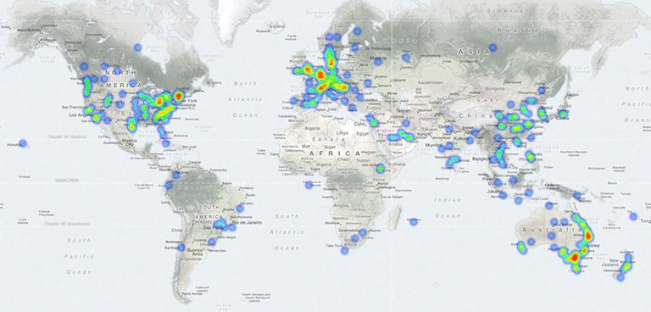
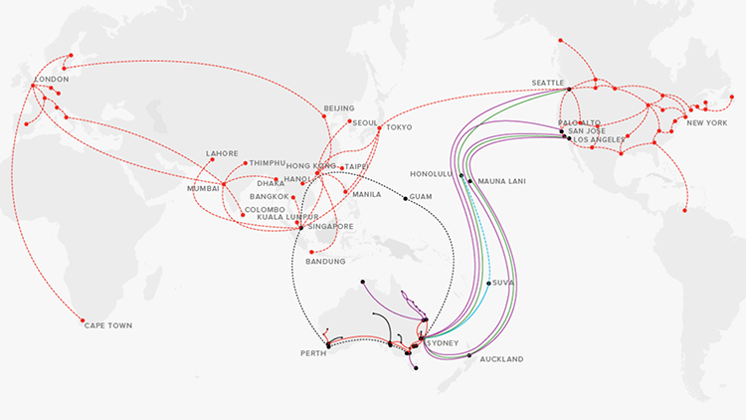
40,000 CloudStor Users
Digital capabilities
Data handling
Network know-how
Notes:
http://rscday.info/2017-program/next-generation-researcher-training-infrastructure-literacy-bof/
https://news.aarnet.edu.au/data-movement-do-you-know-what-your-campus-network-is-actually-capable-of/
https://news.aarnet.edu.au/aarnet-and-southern-cross-cable-network-boost-trans-pacific-research-network-to-100g/
https://news.aarnet.edu.au/cloudstor-is-a-great-tool-for-researchers-heres-why/

Slide 69
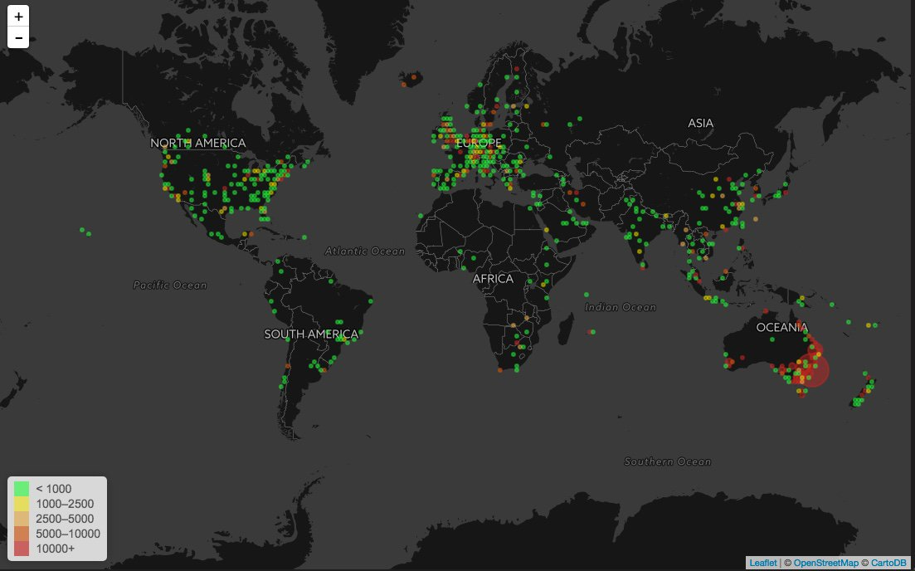

Slide 70
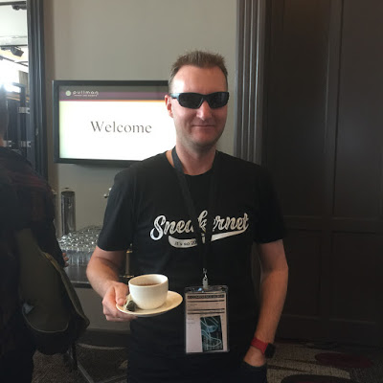
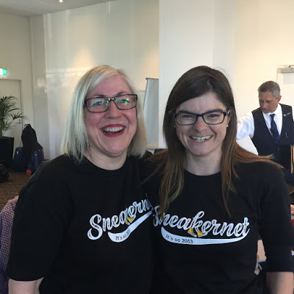
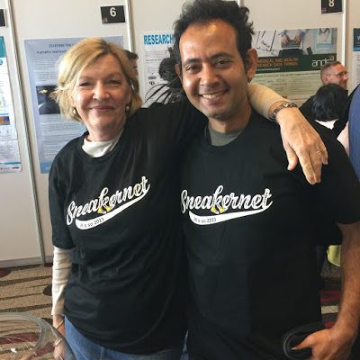
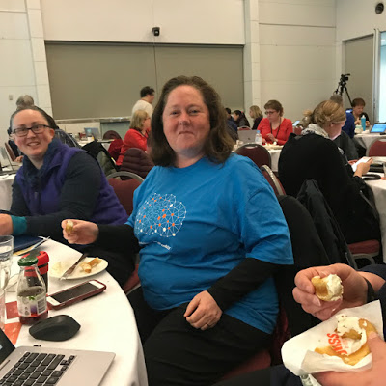
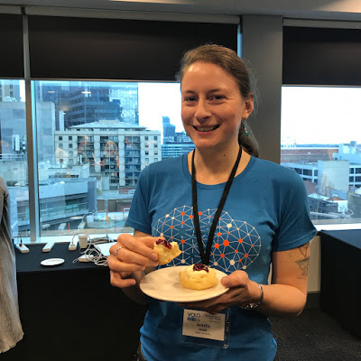
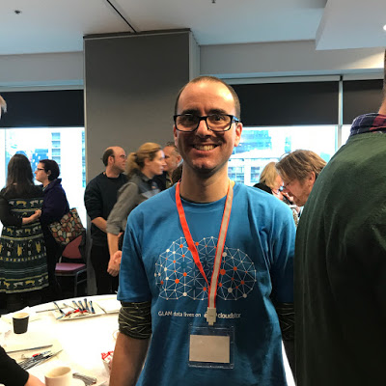
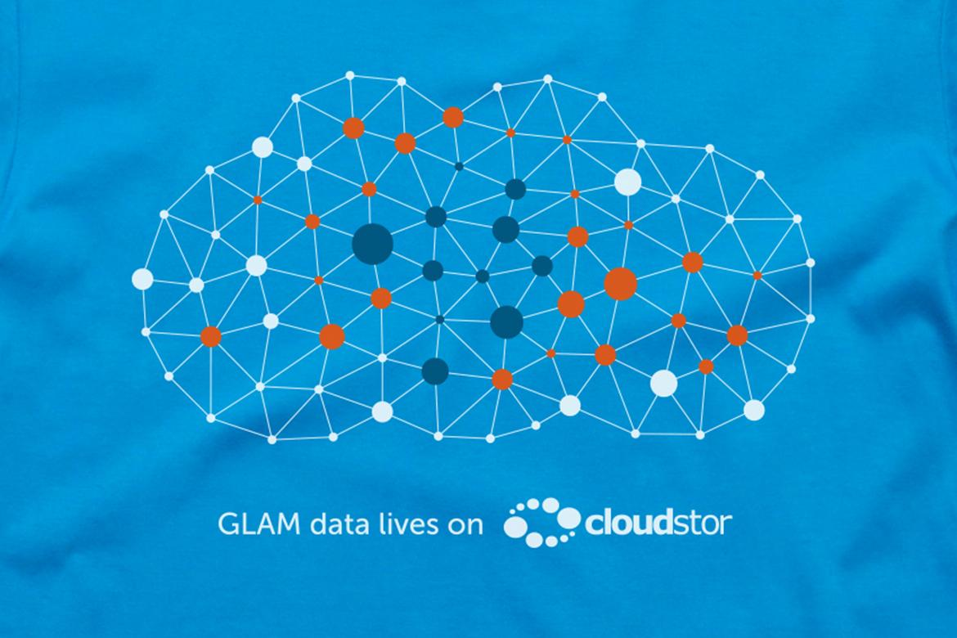
Notes:
https://www.aarnet.edu.au/network-and-services/advanced-network-services/science-dmz
https://news.aarnet.edu.au/breaking-new-ground-for-glam-tech/

Slide 71
Partnerships in eResearch
Network Know-How

Slide 72
Key Terms - Networking
IP - internet protocol (communication and routing of data packets on “inter-network”)
TCP - transmission control protocol (delivery of data packets on IP network)
Bandwidth (bps) - size of the “pipe” for data to flow in
Latency (ms) - time (or delay) measured in milliseconds in sending data between two points
Speed - bandwidth and latency (the amount of data that can be received every second)
Packet loss - failure of a packet of data to reach its destination
Hop - path between networking devices (on a network)
Hop count - number of devices (routers) on a network between start/end points
Notes:
https://en.wikipedia.org/wiki/Hop_(networking)
https://en.wikipedia.org/wiki/Ping_(networking_utility)
https://en.wikipedia.org/wiki/Internet_Protocol
https://en.wikipedia.org/wiki/Transmission_Control_Protocol
https://en.wikipedia.org/wiki/Packet_loss
https://www.dotcom-tools.com/
https://www.paessler.com/monitoring_availability
https://www.lifewire.com/availability-concepts-for-networks-systems-817820
http://networksandservers.blogspot.com.au/2011/02/high-availability-terminology-ii.html
https://en.wikipedia.org/wiki/Data_compression

Slide 73
Computer Networks
Networks can be dedicated or shared.
Networks can be designed with different topologies e.g. spurs, rings, stars.
Networks can carry different levels and types of traffic e.g. Mbps, Gbps.
Networks are affected by interference e.g. microwaves, lift motors, air-conditioning fans.
Networks are physically comprised of cables or wireless media.
Organisations restrict traffic into or out-of their networks via firewall.
Notes:
Think of wifi like rope where you unwind it and hand out each strand (as users log in). The more uses, the less and less rope there is to hand out.
Many laptops link to an access point on the network (the wifi) and that access point divides up the traffic to various radios.
http://www.certiology.com/computing/computer-networking/network-topology.html

Slide 74
Partnerships in eResearch
Data Handling

Slide 75
Data Packaging & Movement (in cloud)
Different paradigms for data packaging and movement e.g. user actions
File syncing
File sharing
File encryption
File sending
Data pumping
Data packaging
Different tools for data packaging, copying, and movement i.e. data handling
ownCloud (sync & share)
CloudStor (groups share & encryption)
FileSender (send)
Rocket (pump)
Collections (package)
Notes:
https://www.aarnet.edu.au/network-and-services/cloud-services-applications/cloudstor
https://support.aarnet.edu.au/hc/en-us/articles/206128177-Does-CloudStor-work-with-ownCloud-s-Sync-Clients-
https://news.aarnet.edu.au/new-cloudstor-milestone-reached-30000-users-and-growing/
https://support.aarnet.edu.au/hc/en-us/articles/115007581907-What-is-CloudStor-Rocket-
https://support.aarnet.edu.au/hc/en-us/sections/115000264274-CloudStor-Collections

Slide 76
CHALLENGES

Slide 77
GENOMICS
A game changer
Today
300 hours of YouTube video/minute ~ 100 petabytes/year
250,000 human genome sequences ~ 25 petabytes/year
2025
1,700 hours of YouTube video/min ~ 2 exabytes/year
2 billion human genome sequences ~ 2 > 40 exabytes/year

Slide 78
Networkshop
June 2017
National forum for technologists working on networking and technologies (from AARNet connected universities and research institutions.
Notes:
https://networkshop.aarnet.edu.au/
Networkshop interviews with workshop participants (June 2017)
Internet of Things - more devices and people on the network & change in demand - Peter Hughes, Manager Network services, University of Adelaide
Data management - scientific and corporate data & personal vs professional use of internet and ICT - Amanda Gildea, ICT Manager, Australian Antarctic Division
High speed connections for international collaboration e.g. Copernicus (European Space Agency) - Andrew Howard, HPC Systems Administrator, National Computational Infrastructure
Change, automation and security - David Rhodes, Network Engineering Team Leader, Deakin University
Funding, student retention, ethical hacking, supporting research, geographic distance - Douglas Harŕe, Chief Engagement Officer, REANNZ
Support for research and balancing their needs for international collaboration and open access with general security concerns - John McHale, Network Solutions Engineer, RMIT
Need to use national facilities in research and moving PB of research data - Jason Andrade, Consultant (Research IT), University of Wollongong
Ensuring stability of the network - Kevin Lane, Senior Infrastructure Engineer, James Cook University
Security, research outcomes & university operations in balance, create new solutions - David Wilde, Chief Technology Officer
Growth and change in demand
Accommodate changes to meet demand
Personal and professional use of internet
International and national collaboration
Capturing and moving PB of data
Refocusing to address tough problems and getting a foothold
Common/shared challenges in Australia and New Zealand
Ethics, funding, supporting research, geographic distance
Balancing open access versus general requirements for security
New working relationships and processes
Monitoring what’s happening and troubleshooting
Opportunities and create new solutions

Slide 79
Networking Challenges in eResearch
Demand -
Growth and need to accommodate changes
Common/shared challenges in ethics, funding, supporting research, geographic distance
Balancing open access versus general requirements for security
Usage -
New working relationships and processes
Personal and research use of internet
National and international research collaboration
Capturing and moving PB of research data
Approach -
Refocusing to address tough problems and getting a foothold
Monitoring what’s happening and troubleshooting
Opportunities to create new solutions

Slide 80
Digital Capability Challenges in eResearch
Demand -
Growth and change
Common/shared challenges Balancing/prioritising requirements
Usage -
New practices
Online identities
Global collaboration
Data handling
Approach -
Monitoring
Refocusing
Addressing problems
Getting a foothold
Opportunities
New solutions

Slide 81
Repositioning Library and Information Services
Demand
Usage
Approach

Slide 82
Universities
Government
Industry
Information Technology
Library
Research
Senior Management
Science
Cultural Heritage
Health
K-12 Schools
Digital Humanities
eResearch
NRENs

Slide 83
NEW PARTNERSHIPS
Information Technology
Library
Research
Notes:
https://www.flickr.com/photos/quinet/11960457934/
https://creativecommons.org/licenses/by/2.0/

Slide 84
Partnerships in eResearch
“"... I think we're moving into a new technological era, one that's characterised less by devices and more by data circulation, curation, collection and commodification ... and I think how we find the right tools both intellectually and arguably at a skill set level to tackle that's going to be a pressing problem.”
Prof Genevieve Bell,
3A Institute, ANU & Data61
Technology translation and guidance is needed to build digital capabilities in eResearch.
Library and information specialists have an important role to play in infrastructure literacy.
Notes:
http://www.canberratimes.com.au/act-news/australian-national-university-announces-artificial-intelligence-expansion-20170904-gya4pp.html

Slide 85
THANK YOU

Slide 86
Ingrid Mason
Deployment Strategist
ingrid.mason@aarnet.edu.au
@AARNet @1n9r1d

